Slide 1
DISASTER
PREPAREDNESS
space
THE TO BE
THE SPACE TO BE

Slide 2
prepared
GET
Why should you be prepared?
Helps you and those around you SURVIVE
Emergency resources could be limited
Reduces fear and anxiety

Slide 3
ACTION STEPS TO PREPAREDNESS
Flexible and Modular
Get Informed
Create A Plan
Assemble a Disaster Kit
Democratic

Slide 4
informed
GET

Slide 5
informed
GET
Types of disasters in our area:
Flooding
Tornadoes
Lighting
Fires
Winter Storms

Slide 6
informed
GET
Flooding – What To Do
Get out of areas subject to flooding
Avoid already flooded areas
DO NOT attempt to cross flowing streams. TURN AROUND DON’T DROWN!
If vehicle stalls, leave it immediately and seek higher ground
DO NOT attempt to start a stalled vehicle
Be especially cautious at night, it is harder to recognize flood dangers
Children should NEVER play around high water, storm drains, or around creeks

Slide 7
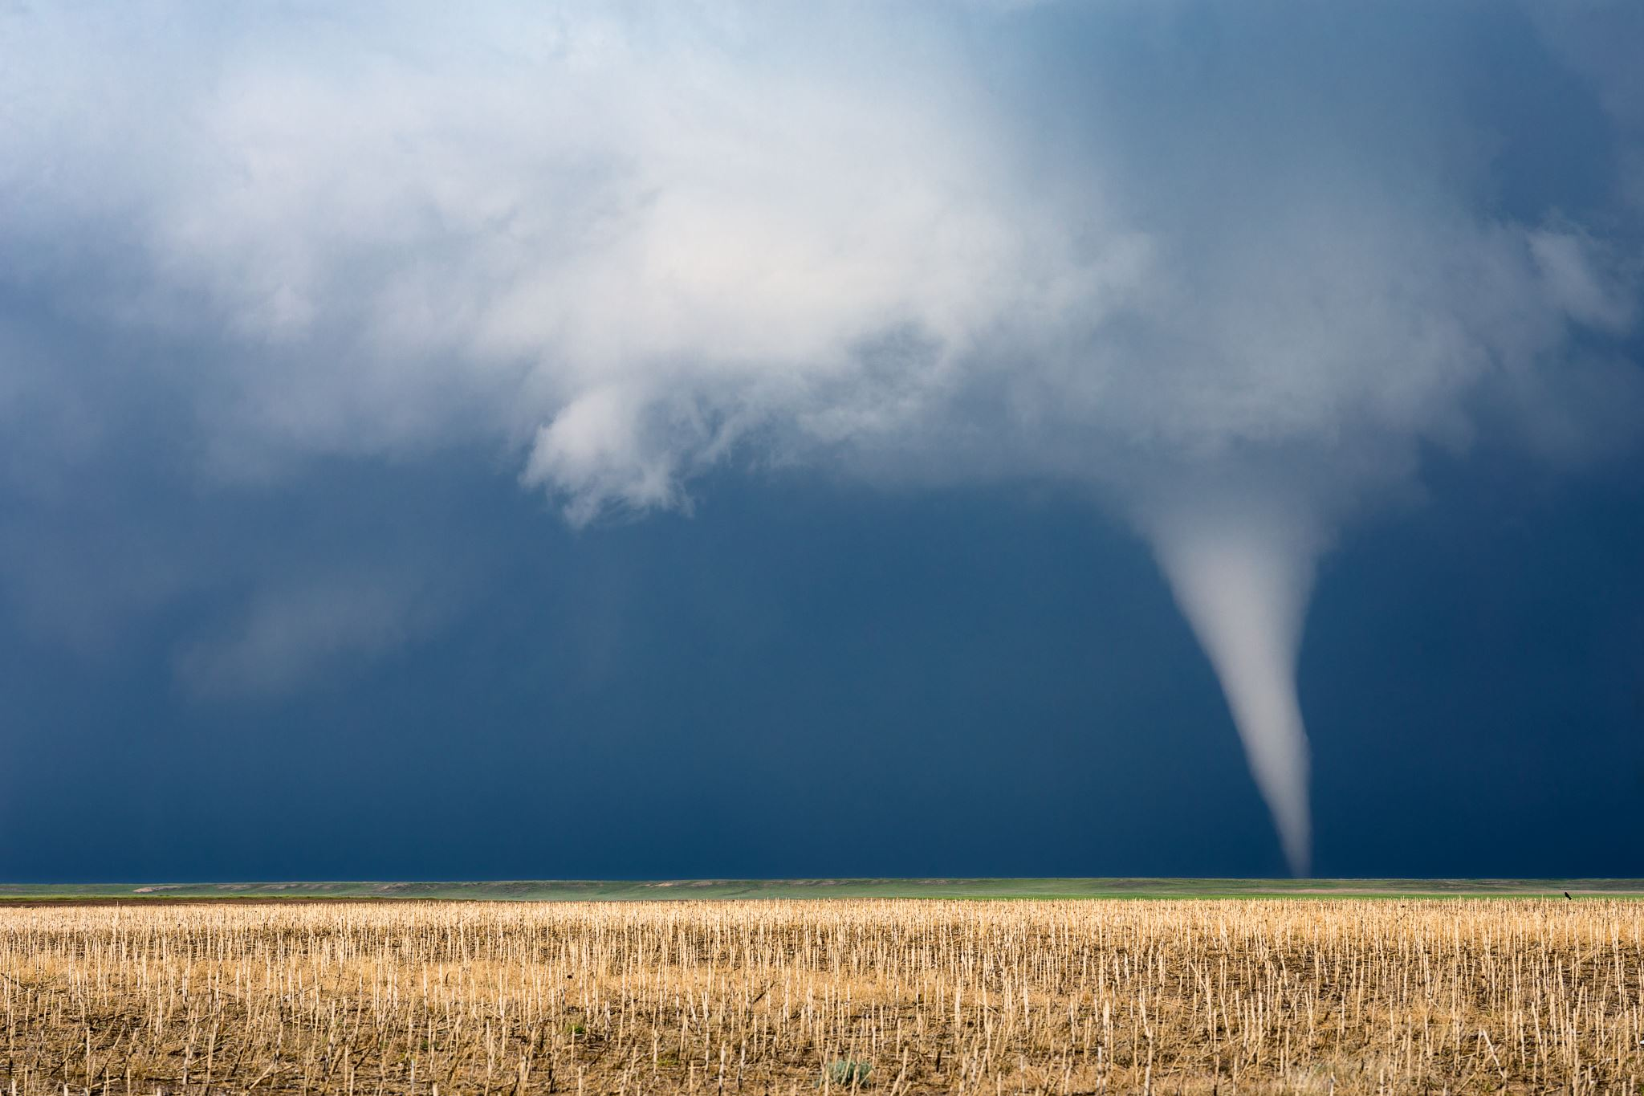
informed
GET
Tornado – What To Do
During a storm, listen to local news / weather station or monitor using weather apps
Know your community’s warning system
Pick a safe room in your home to gather
This should be a basement or lowest floor with no windows
Consider having the safe room reinforced
Watch for tornado danger signs
Dark often greenish clouds
Funnel cloud – a visible extension of the cloud base
Roaring noise

Slide 8
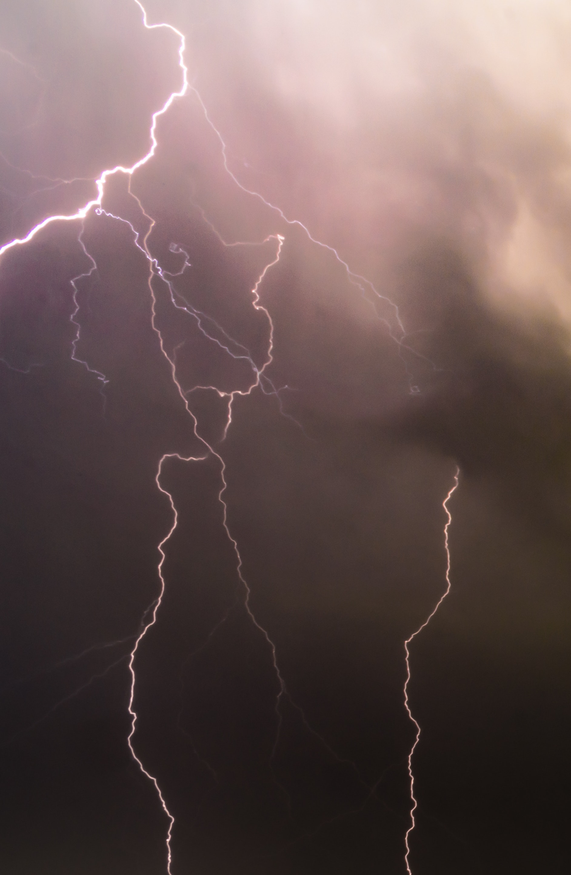
informed
GET
Lighting – What To Do
If caught in a thunderstorm, the only completely safe action is to get inside a building or car
If a safe location is not nearby:
Avoid open fields and hilltops
Stay away from tall isolated trees or other tall objects
If in a group, spread out to avoid the current travelling between group members
Stay away from water and wet items such as ropes and metal objects
If you are caught on water:
Most lighting injuries and fatalities occur on small boats with no cabins
If rain or thunderstorms are forecasted, DO NOT GO OUT IN WATER

Slide 9
informed
GET
Fire – What To Do
Home Fire Safety:
Install smoke alarms on every level of your home, inside bedrooms and outside sleeping areas.
Test smoke alarms every month. If they’re not working, change the batteries.
Talk with all family members about a fire escape plan and practice the plan twice a year.
If a fire occurs in your home, GET OUT, STAY OUT and CALL FOR HELP. Never go back inside for anything or anyone.
Wildfire Safety at Home:
Fill your sinks and bathtubs with cold water.
Keep your doors and windows shut, but don’t lock them.
Remove any window coverings and move fabric-covered furniture away from windows and sliding doors.
Use hoses or sprinklers to wet your roof, walls, and the ground around your home, if you can do it safely.
Stay inside and away from windows and exterior walls.

Slide 10
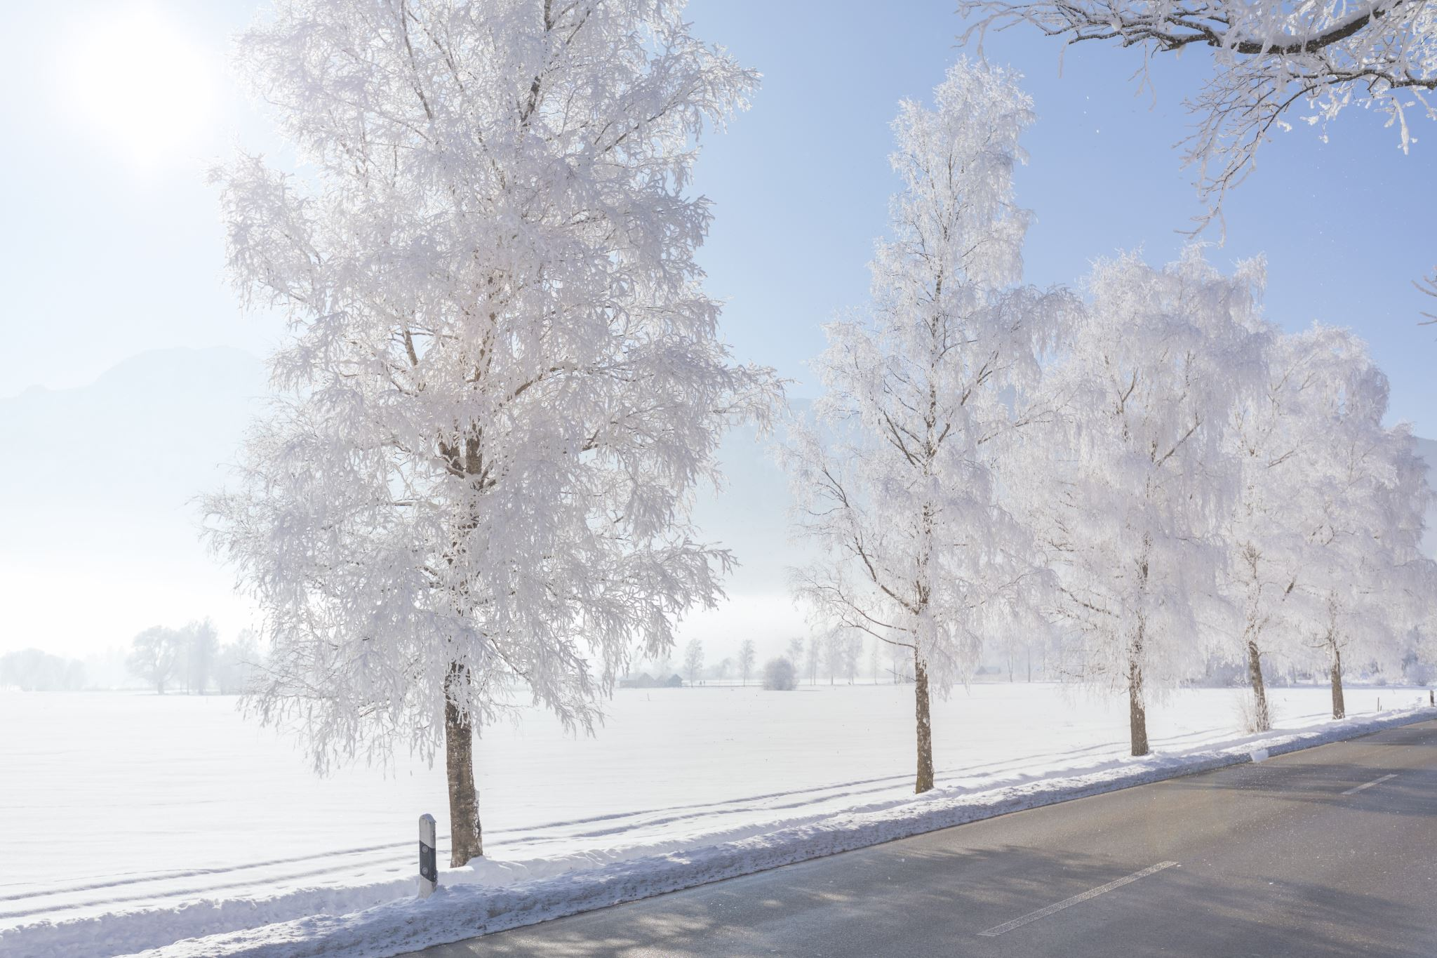
informed
GET
Winter Storm – What To Do
Winterize your vehicle and keep the gas tank full. A full tank will keep the fuel line from freezing.
Insulate your home by installing storm windows or covering windows with plastic from the inside to keep cold air out.
Maintain heating equipment and chimneys by having them cleaned and inspected every year.
Running water, even at a trickle, helps prevent pipes from freezing.
Never use a generator, grill, camp stove or other gasoline, propane, natural gas or charcoal-burning devices inside a home, garage, basement, crawlspace or any partially enclosed area.
Install carbon monoxide alarms in central locations on every level of your home and outside sleeping areas to provide early warning of accumulating carbon monoxide. If the alarm sounds, move quickly to fresh air location outdoors and call from help there. Do not go back inside until emergency personnel arrives to assist you.
Dress in several layers of lightweight clothing, wear mittens and a hat (preferably one that covers your ears).
Wear waterproof, insulated boots to keep your feet warm and dry and to maintain your footing in ice and snow.
Bring pets/companion animals inside during winter weather. Move other animals or livestock to sheltered areas with non-frozen drinking water.

Slide 11
informed
GET
Mobile Apps
Mobile apps can help you prepare for severe weather
Red Cross
NOAA
Weather – The Weather Channel
Storm Shield

Slide 12
a plan
CREATE

Slide 13
a plan
CREATE
What to include in plan:
Plan on surviving on your own for at least 72 hours
Know your evacuation routes
Plan for all services to be unavailable
Identify a “family” contact
Inventory home possessions for insurance purposes
Copy important documents
Know where your disaster kit is located
Learn how to use a fire extinguisher
Learn how to shelter in place
Learn where all your notifications come
Plan for an alternative safe location for pets and make copies of pet documents
Maintaining your plan:
Practice your plans
Keep information updated on a regular basis
Let your outside contact know where you keep your kit and what your plan is in the event of a disaster

Slide 14
a plan
CREATE
What to include in disaster kit:
It must be easily accessible in your home or office
Water - one gallon per person per day (for everyone in the household for at least 72 hours)
Non-perishable food that is easy to prepare (for everyone in household for at least 72 hours)
Can opener
Multi-purpose tool
Cell phone and chargers with extra battery packs
Games and books for children
Copies of personal documents
Battery-operated or hand crank radio
Flashlights and candles
Extra batteries
Over the counter medicine and medications (7-day supply)
First aid kit
Change of clothes for members of the family
Blankets
Emergency whistle
Hand sanitizer and personal hygiene items
Baby supplies
Pet supplies
Cash

Slide 15
SKG
specific
Nick Remmell

Slide 16
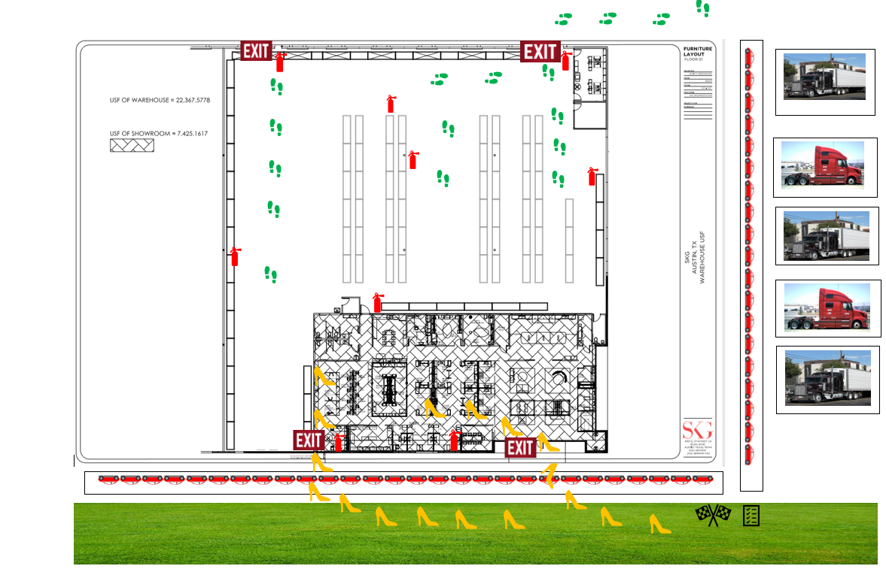

Slide 17
space
THE TO BE
SKG Austin Showroom
6301 East Stassney Lane l Building. 9-100
Austin, Texas 78744-3069
(512) 481-1500
SKG San Antonio Showroom
1627 Broadway
San Antonio, Texas 78215
(210)320-2500

